Slide 1
CS 5683: Algorithms & Methods for Big Data Analytics Analysis of Large Graphs: Community Detection
Arunkumar Bagavathi
Department of Computer Science
Oklahoma State university

Slide 2
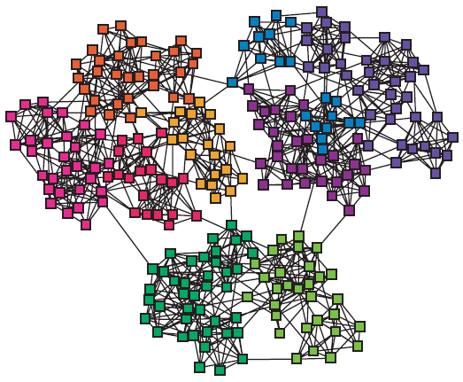
Networks and Communities
We often think of networks being organized into modules, cluster, communities:

Slide 3
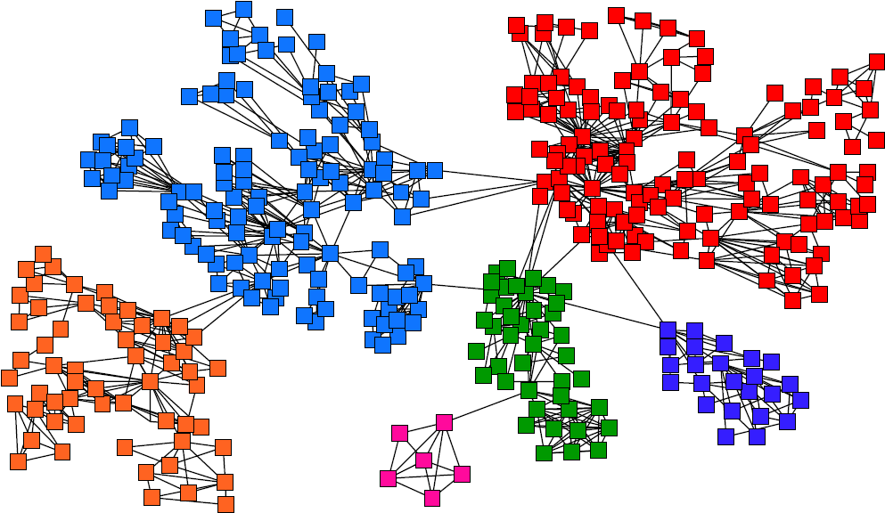
Goal: Find Densely Linked Clusters

Slide 4
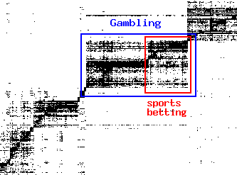
Micro-Markets in Sponsored Search
Find micro-markets by partitioning the query-to-advertiser graph
query
advertiser
[Andersen, Lang: Communities from seed sets, 2006]

Slide 5
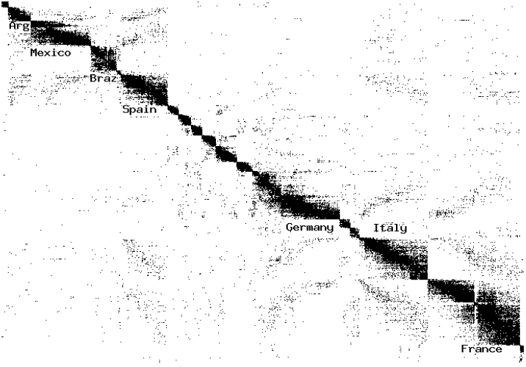
Movies and Actors
Clusters in Movies-to-Actors graph:
[Andersen, Lang: Communities from seed sets, 2006]

Slide 6
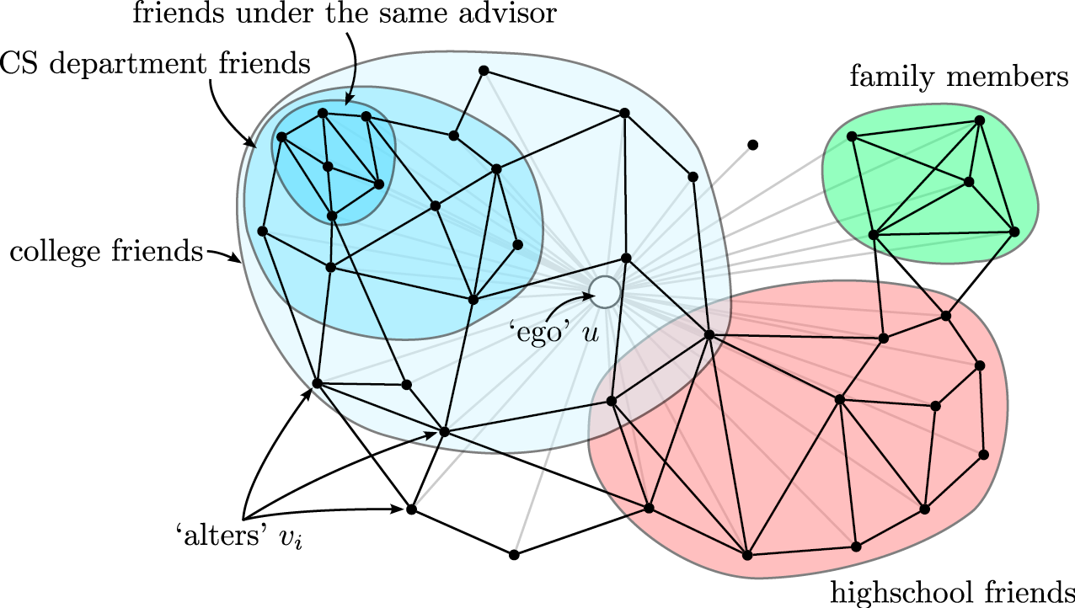
Twitter & Facebook
Discovering social circles, circles of trust
[McAuley, Leskovec: Discovering social circles in ego networks, 2012]

Slide 7
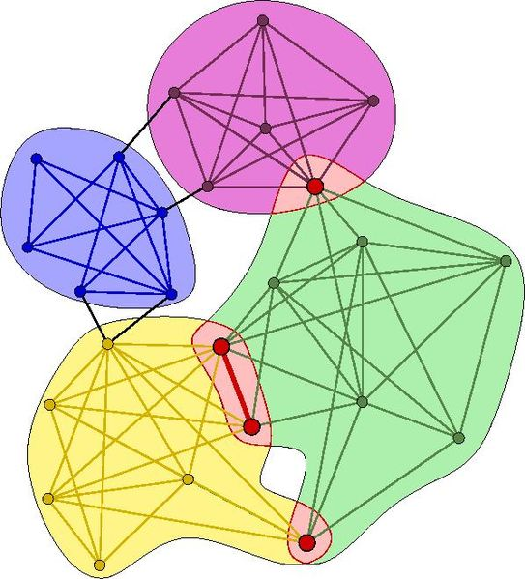
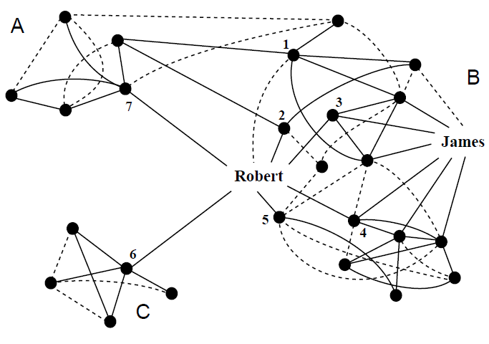
Community Detection
We will consider undirected & unweighted networks in this course!
How to find communities?

Slide 8
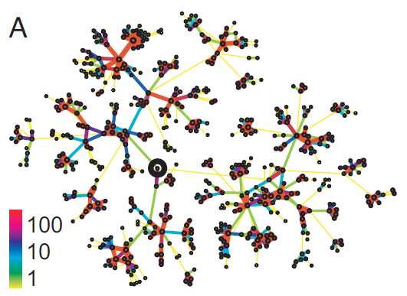
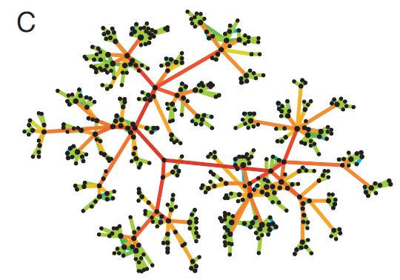
Method – 1: Strength of Weak Ties
Edge Betweenness: Number of shortest paths passing over the edge
Intuition:
b=16
b=7.5
Edge strengths (call volume) in a real network
Edge betweenness in a real network

Slide 9
Method – 1: Girvan-Newman
Divisive hierarchical clustering based on the notion of edge betweenness:
Number of shortest paths passing through the edge
Girvan-Newman Algorithm:
Undirected unweighted networks
Repeat until no edges are left:
Calculate betweenness of edges
Remove edges with highest betweenness
Connected components are communities
Gives a hierarchical decomposition of the network

Slide 10
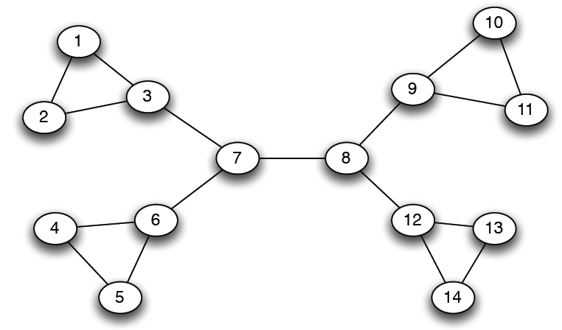
Girvan-Newman: Example
12
1
33
49
Need to re-compute betweenness at every step

Slide 11
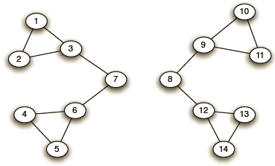
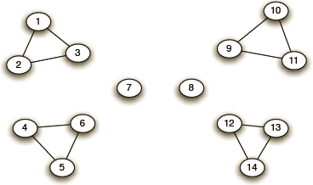
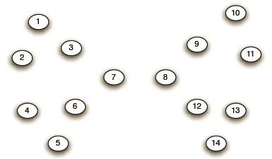
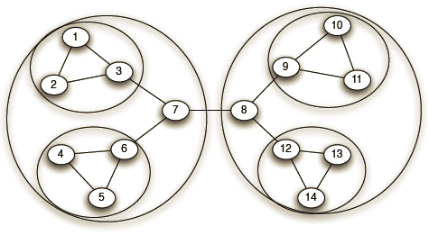
Girvan-Newman: Example
Step 1:
Step 2:
Step 3:
Hierarchical network decomposition:

Slide 12
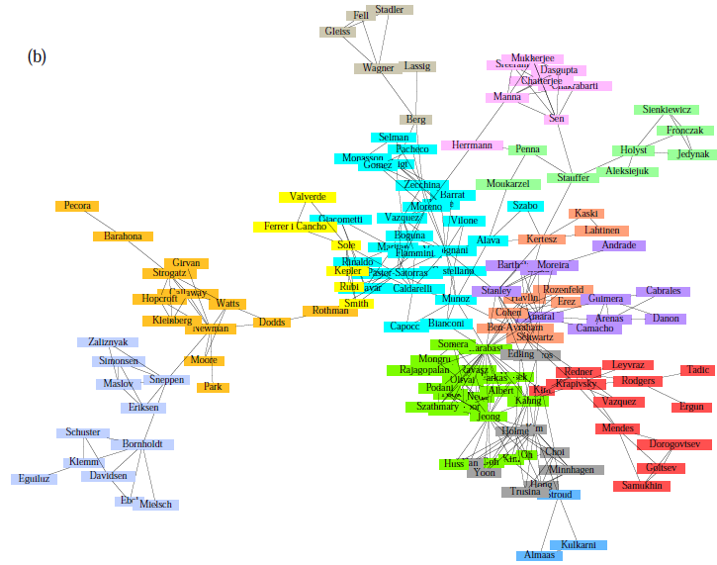
Girvan-Newman: Results
Communities in physics collaborations

Slide 13
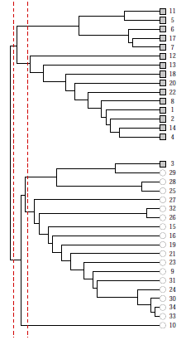
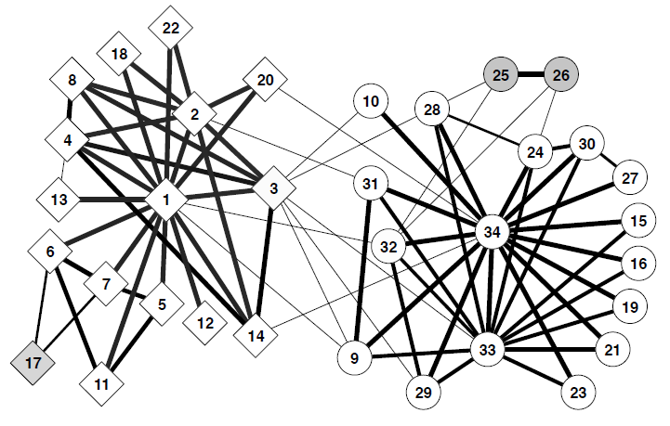
Girvan-Newman: Results
Zachary’s Karate club: Hierarchical decomposition

Slide 14
We need to Resolve 2 Questions
How to compute edge betweenness?
How to select the number of clusters?

Slide 15
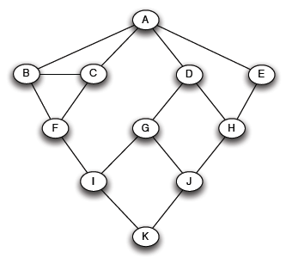
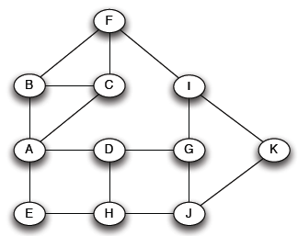


Q1: How to Compute Betweenness
Want to compute betweenness of paths starting at node $A$
Breath first search starting from $A$:
0
1
2
3
4

Slide 16
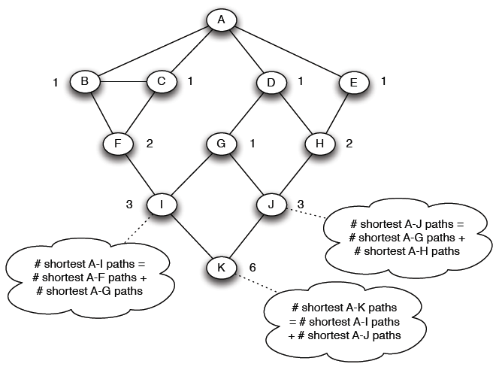
Q1: How to Compute Betweenness?
Forward step: Count the number of shortest paths from A to all other nodes of the network:

Slide 17
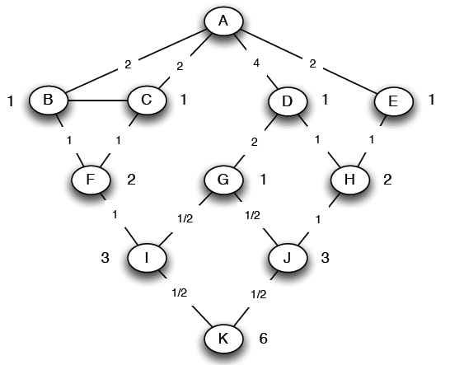

Q1: How to Compute Betweenness?
Backward step: Compute betweenness by working up the tree: If there are multiple paths count them fractionally
The algorithm:
Add edge flows:
-- node flow = 1+∑child edges
-- split the flow up based on the parent value
Repeat the BFS procedure for each starting node $U$
1+1 paths to H
Split evenly
1+0.5 paths to J
Split 1:2
1 path to K.
Split evenly

Slide 18
Q1: How to Compute Betweenness?
Backward step: Compute betweenness by working up the tree: If there are multiple paths count them fractionally
The algorithm:
Add edge flows:
-- node flow = 1+∑child edges
-- split the flow up based on the parent value
Repeat the BFS procedure for each starting node $U$
1+1 paths to H
Split evenly
1+0.5 paths to J
Split 1:2
1 path to K.
Split evenly

Slide 19
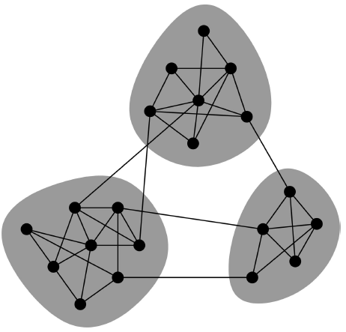
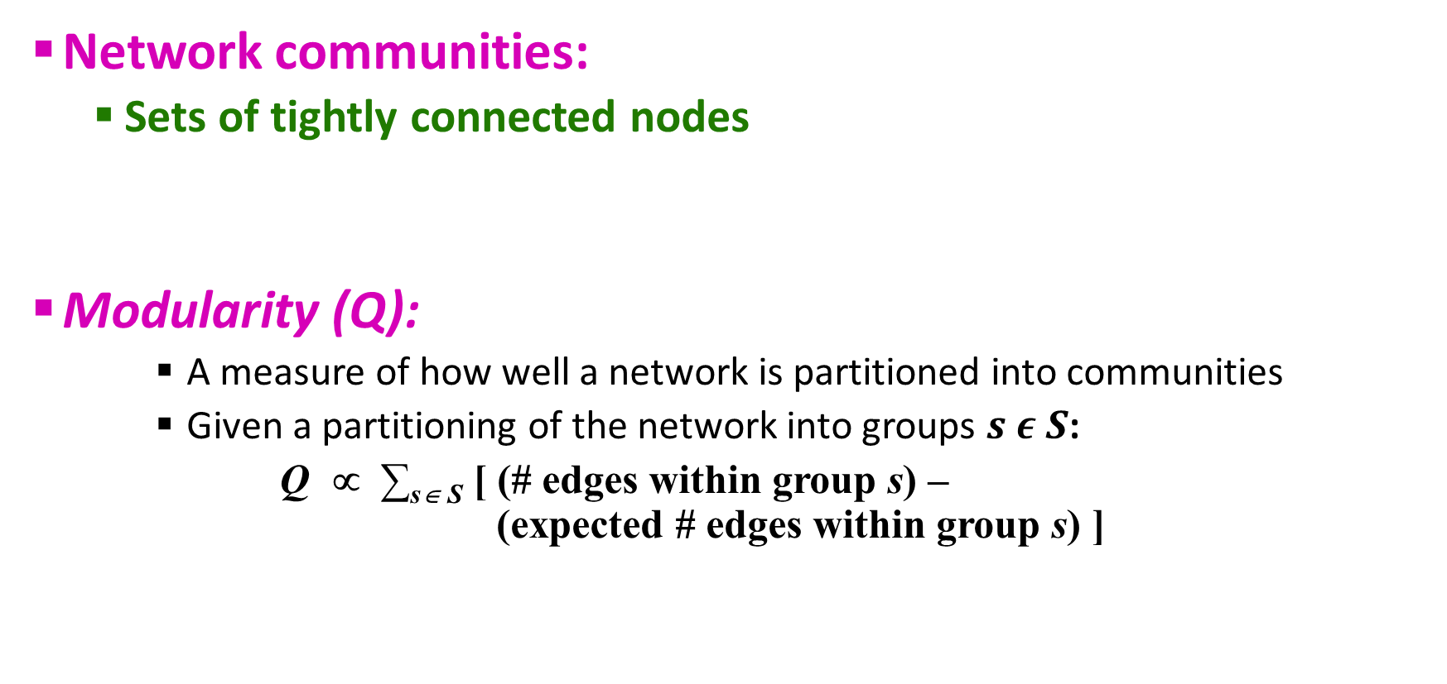
Q2. How to select the Number of Clusters?
Network communities:
Sets of tightly connected nodes
Modularity (Q):
A measure of how well a network is partitioned into communities
Given a partitioning of the network into groups $s ε S$:
Q ∝ ∑_{s∈ S} [ (# edges within group s) – (expected # edges within group s) ]
Need a null model!

Slide 20
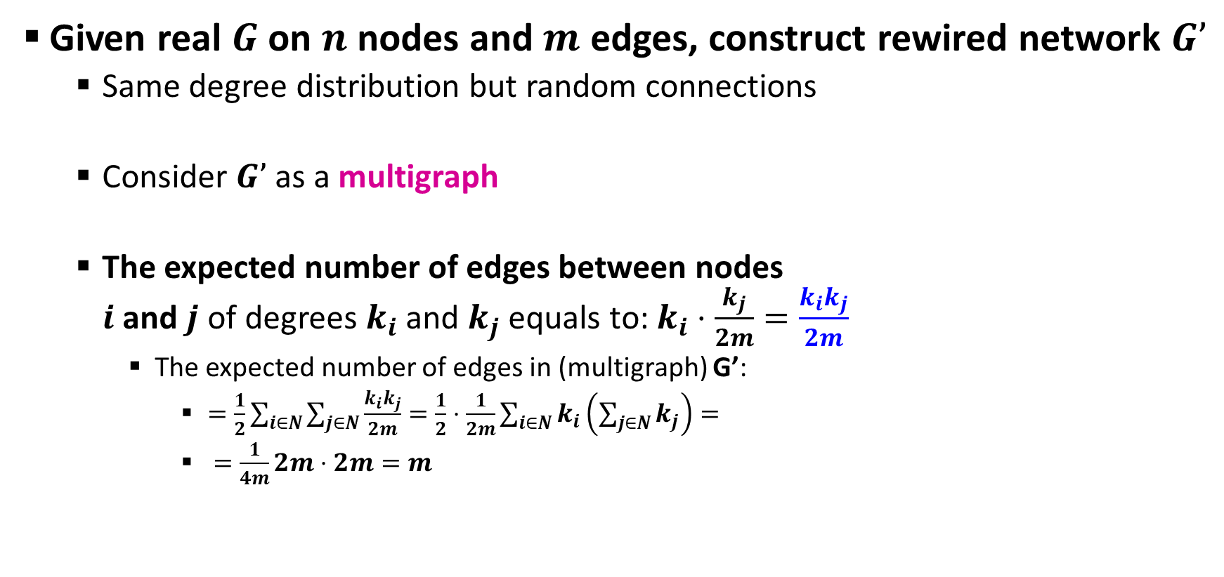

Null Model: Configuration Model
Given real $G$ on $n$ nodes and $m$ edges, construct rewired network $G’$
Same degree distribution but random connections
Consider $G’$ as a multigraph
The expected number of edges between nodes $i$ and $j$ of degrees $k_{i}$and $k_{j}$ equals to: $k_{i}⋅\frac{k_{j}}{2m}=\frac{k_{i}k_{j}}{2m}$
The expected number of edges in (multigraph) G’:
$=\frac{1}{2}\sum_{i∈N}{\sum_{j∈N}{\frac{k_{i}k_{j}}{2m}}}=\frac{1}{2}⋅\frac{1}{2m}\sum_{i∈N}{k_{i}\left(\sum_{j∈N}{k_{j}}\right)}=$
$=\frac{1}{4m}2m⋅2m=m$
i
j
$$\sum_{u∈N}{k_{u}}=2m$$

Slide 21
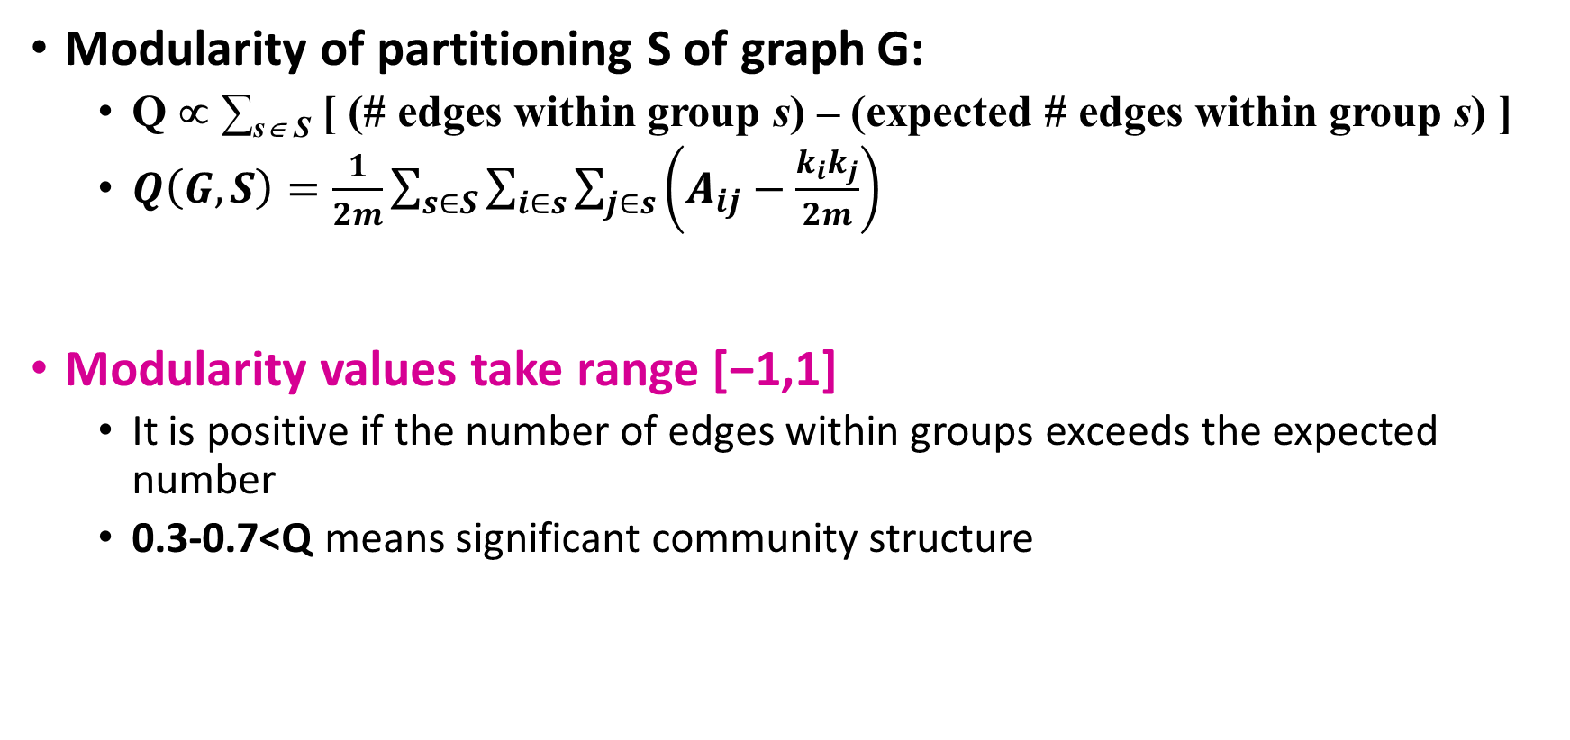
Modularity
Modularity of partitioning S of graph G:
Q ∝ ∑_{s∈ S} [ (# edges within group s) – (expected # edges within group s) ]
$Q\left(G,S\right)=\frac{1}{2m}\sum_{s∈S}{\sum_{i∈s}{\sum_{j∈s}{\left(A_{ij}−\frac{k_{i}k_{j}}{2m}\right)}}}$
Modularity values take range [−1,1]
It is positive if the number of edges within groups exceeds the expected number
0.3-0.7<Q means significant community structure
A_{ij} = 1 if i→j, 0 else
Normalizing cost.: -1<Q<1

Slide 22
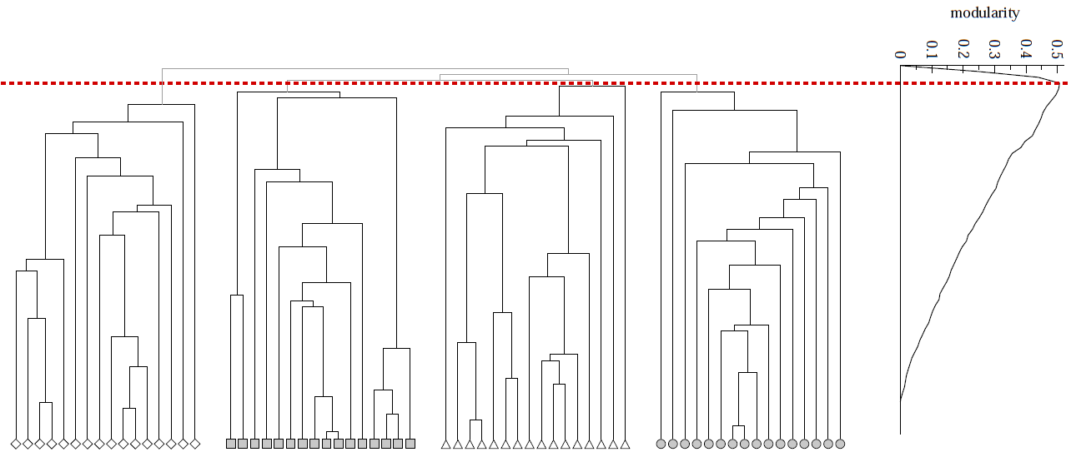
Modularity: Number of Clusters
Modularity is useful for selecting the number of clusters:
Next time: Why not optimize Modularity directly?

Slide 23
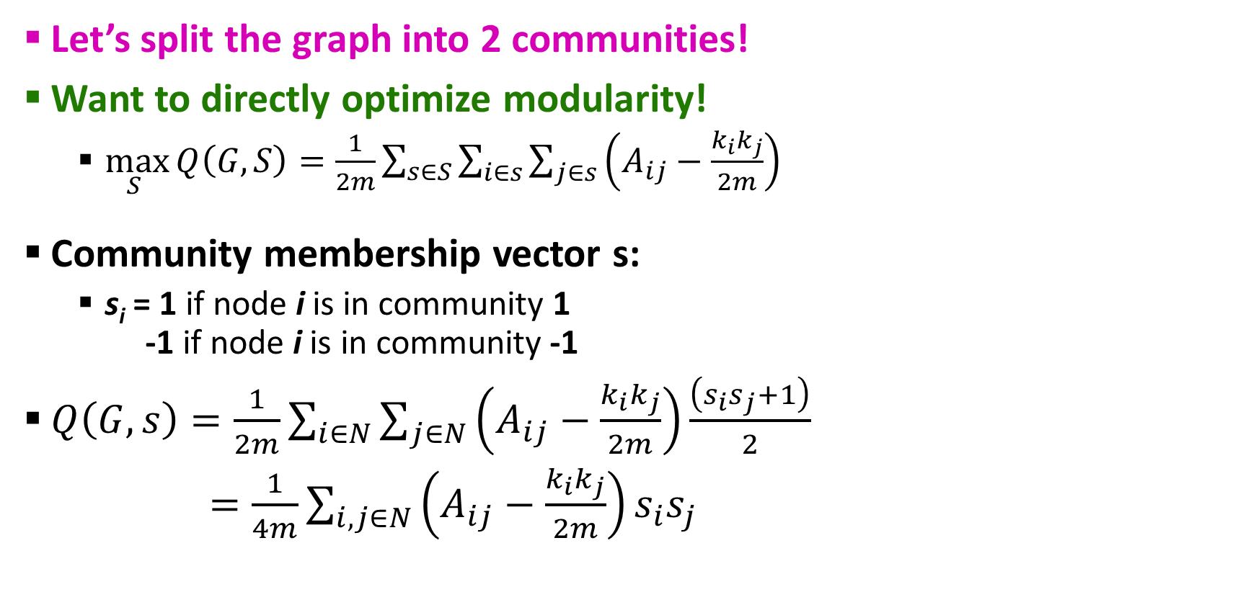

Method – 2: Modularity Optimization
Let’s split the graph into 2 communities!
Want to directly optimize modularity!
$\max_{S }{Q\left(G,S\right)=\frac{1}{2m}\sum_{s∈S}{\sum_{i∈s}{\sum_{j∈s}{\left(A_{ij}−\frac{k_{i}k_{j}}{2m}\right)}}}}$
Community membership vector s:
s_{i} = 1 if node i is in community 1 -1 if node i is in community -1
$Q\left(G,s\right)=\frac{1}{2m}\sum_{i∈N}{\sum_{j∈N}{\left(A_{ij}−\frac{k_{i}k_{j}}{2m}\right)\frac{\left(s_{i}s_{j}+1\right)}{2}}}$
$=\frac{1}{4m}\sum_{i,j∈N}{\left(A_{ij}−\frac{k_{i}k_{j}}{2m}\right)s_{i}s_{j}}$
$$\frac{s_{i}s_{j}+1}{2}=$$
1.. if s_{i}=s_{j}
0.. else

Slide 24
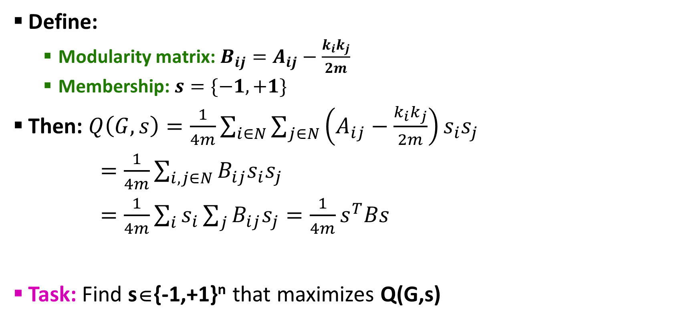
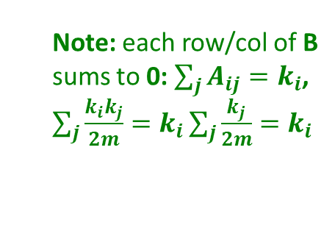
Modularity Matrix
Define:
Modularity matrix:$B_{ij}=A_{ij}−\frac{k_{i}k_{j}}{2m}$
Membership: $s=\{−1, +1\}$
Then: $Q\left(G,s\right)=\frac{1}{4m}\sum_{i∈N}{\sum_{j∈N}{\left(A_{ij}−\frac{k_{i}k_{j}}{2m}\right)s_{i}s_{j}}}$
$=\frac{1}{4m}\sum_{i,j∈N}{B_{ij}s_{i}s_{j}}$
$=\frac{1}{4m}\sum_{i}{s_{i}}\sum_{j}{B_{ij}s_{j}}=\frac{1}{4m}s^{T}Bs$
Task: Find s∈{-1,+1}^{n} that maximizes Q(G,s)
Note: each row/col of B sums to 0: $\sum_{j}{A_{ij}=k_{i}}$, $\sum_{j}{\frac{k_{i}k_{j}}{2m}=k_{i}\sum_{j}{\frac{k_{j}}{2m}}}=k_{i}$

Slide 25
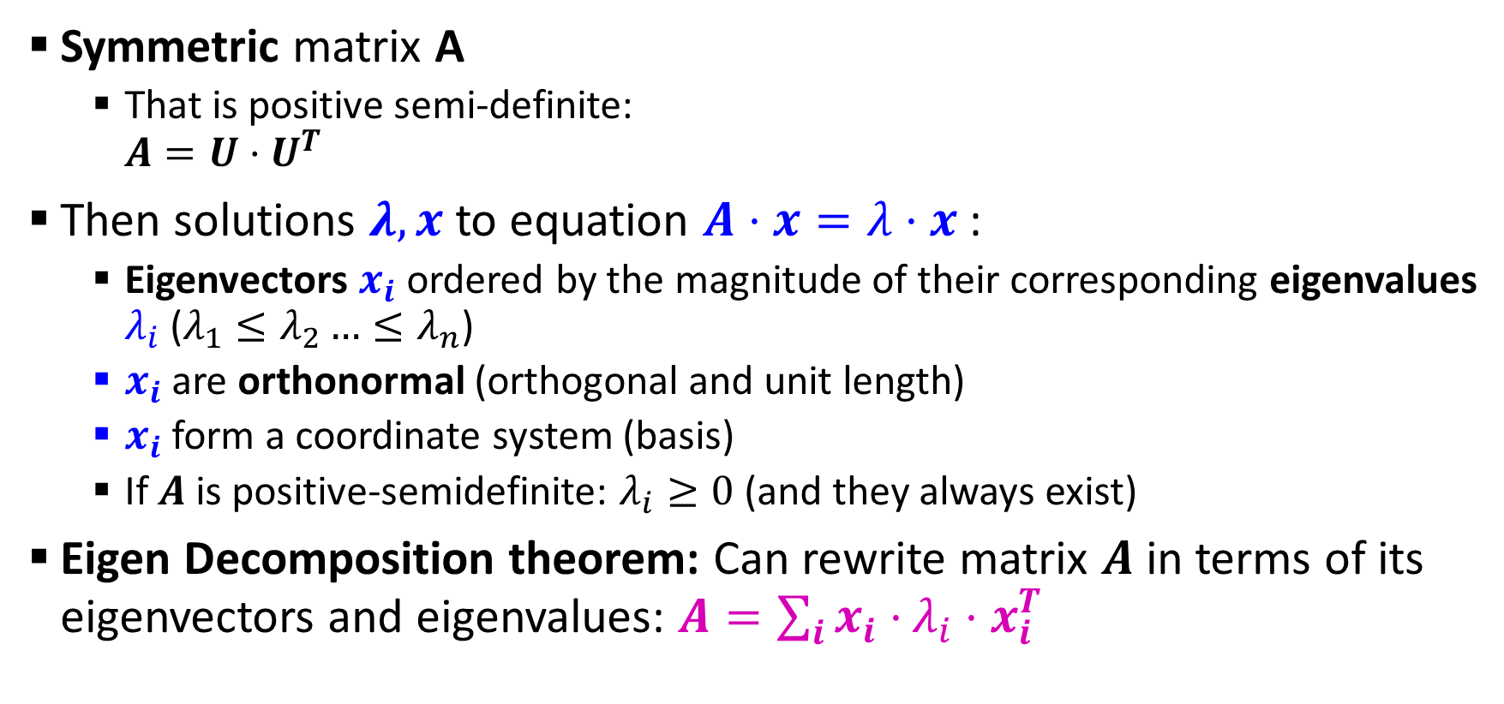
Quick Review of Linear Algebra
Symmetric matrix A
That is positive semi-definite: $A=U⋅U^{T}$
Then solutions $λ,x$ to equation $A⋅x=λ⋅x$:
Eigenvectors $x_{i}$ ordered by the magnitude of their corresponding eigenvalues $λ_{i}$ ($λ_{1}≤λ_{2}…≤λ_{n}$)
$x_{i}$are orthonormal (orthogonal and unit length)
$x_{i}$form a coordinate system (basis)
If $A$ is positive-semidefinite: $λ_{i}≥0$ (and they always exist)
Eigen Decomposition theorem: Can rewrite matrix $A$ in terms of its eigenvectors and eigenvalues: $A=\sum_{i}{x_{i}⋅}λ_{i}⋅x_{i}^{T}$

Slide 26
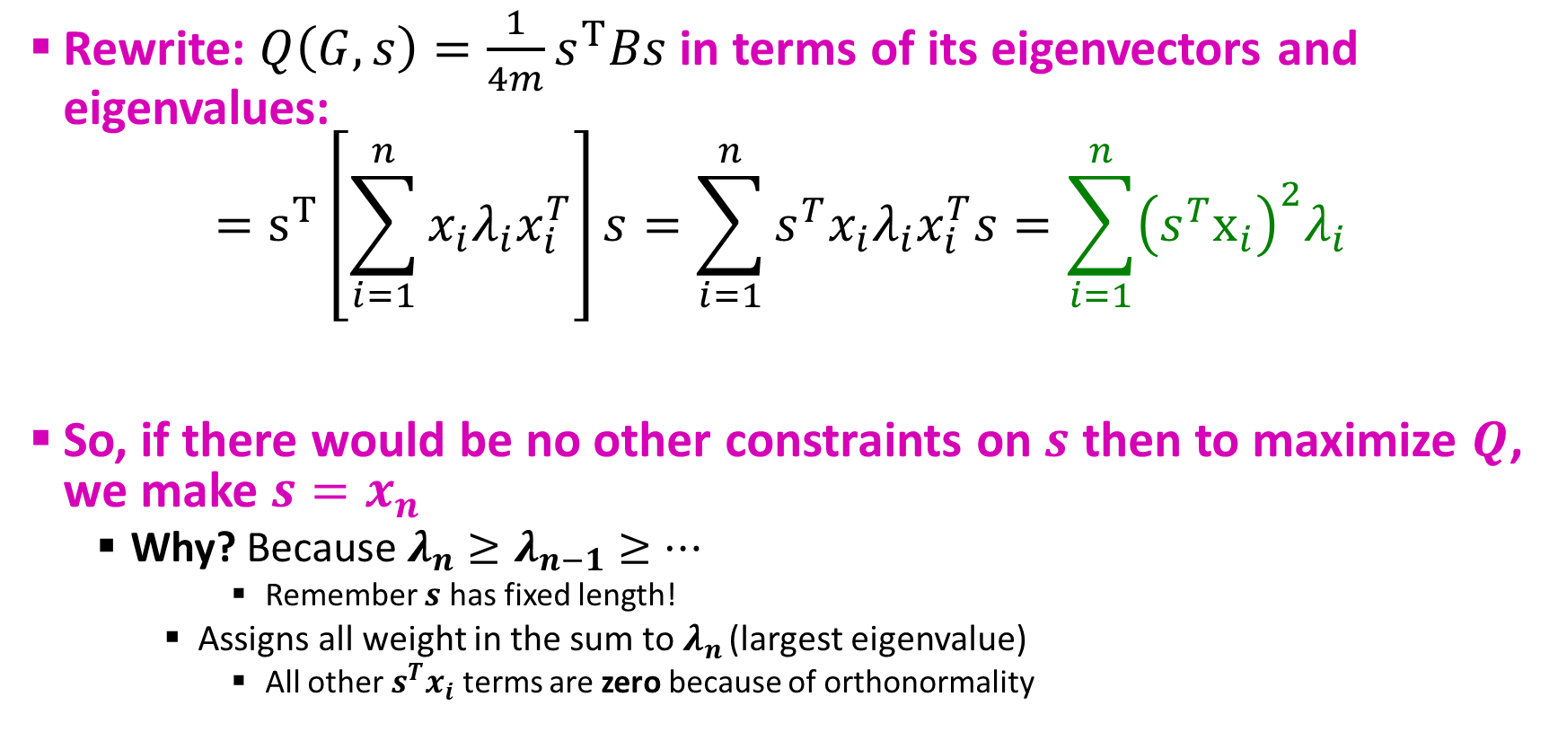
Modularity Optimization
Rewrite: $Q\left(G,s\right)=\frac{1}{4m}s^{T}Bs$ in terms of its eigenvectors and eigenvalues:
$$=s^{T}\left[\sum_{i=1}^{n}{x_{i}λ_{i}x_{i}^{T}}\right]s=\sum_{i=1}^{n}{s^{T}x_{i}λ_{i}x_{i}^{T}s}=\sum_{i=1}^{n}{{\left(s^{T}x_{i}\right)}^{2}λ_{i}}$$
So, if there would be no other constraints on $s$ then to maximize $Q$, we make $s=x_{n}$
Why? Because $λ_{n}≥λ_{n−1}≥…$
Remember $s$ has fixed length!
Assigns all weight in the sum to $λ_{n}$ (largest eigenvalue)
All other $s^{T}x_{i}$ terms are zero because of orthonormality
x₂
s
x₁

Slide 27
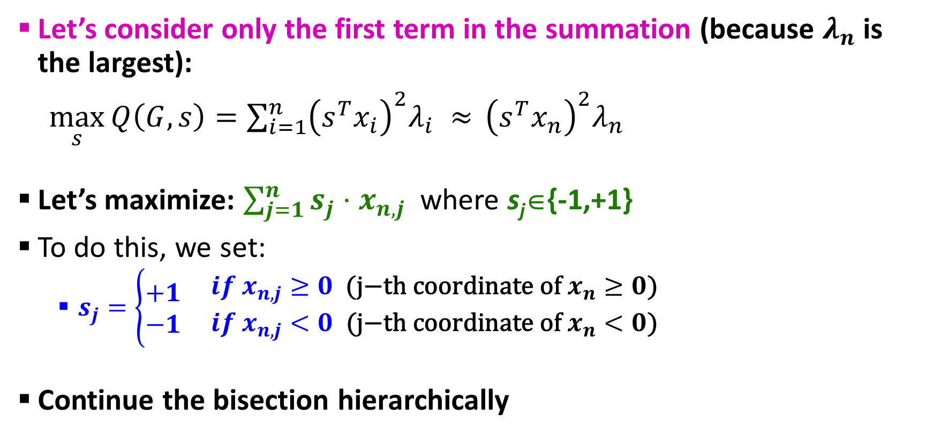
Finding the vector s
Let’s consider only the first term in the summation (because $λ_{n}$ is the largest):
$\max_{s}{Q\left(G,s\right)=\sum_{i=1}^{n}{{\left(s^{T}x_{i}\right)}^{2}λ_{i}} ≈ }{\left(s^{T}x_{n}\right)}^{2}λ_{n}$
Let’s maximize: $\sum_{j=1}^{n}{s_{j}{⋅x}_{n,j}}$ where s_{j}∈{-1,+1}
To do this, we set:
$s_{j}=\left\{\begin{matrix}+1 \\ −1\end{matrix} \begin{matrix}if x_{n,j}≥0 \text{(}\text{j}\text{−}\text{th} \text{coordinate} \text{of} x_{n}≥0\text{)} \\ if x_{n,j}<0 \text{(}\text{j}\text{−}\text{th} \text{coordinate} \text{of} x_{n}<0\text{)}\end{matrix}\right.$
Continue the bisection hierarchically

Slide 28
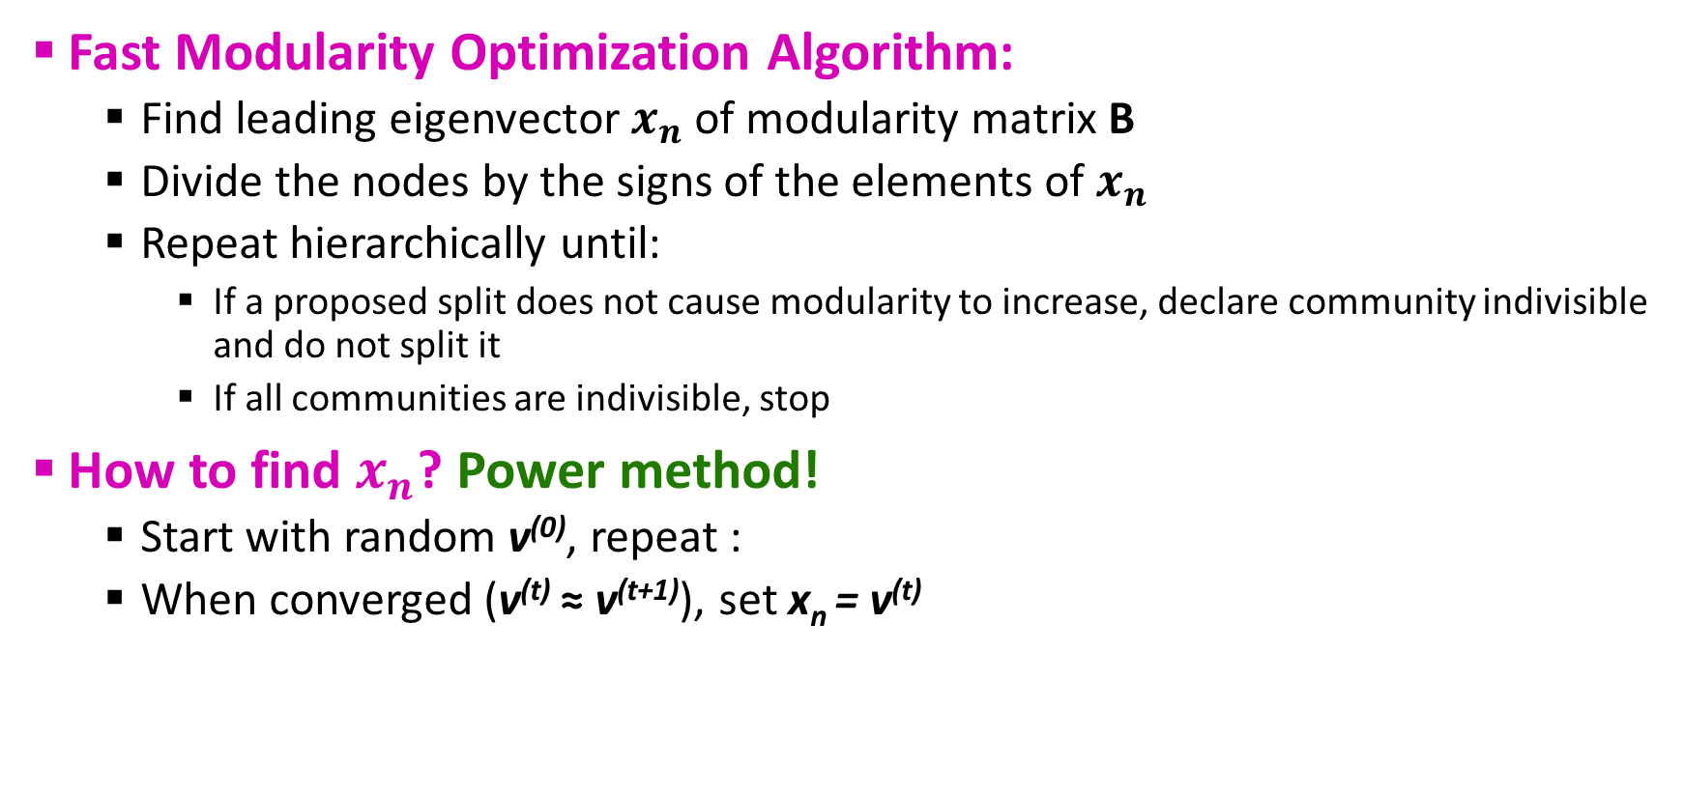
Summary: Modularity Optimization
Fast Modularity Optimization Algorithm:
Find leading eigenvector $x_{n}$ of modularity matrix B
Divide the nodes by the signs of the elements of $x_{n}$
Repeat hierarchically until:
If a proposed split does not cause modularity to increase, declare community indivisible and do not split it
If all communities are indivisible, stop
How to find $x_{n}$? Power method!
Start with random v⁽⁰⁾, repeat :
When converged (v^{(t)} ≈ v^{(t+1)}), set x_{n} = v^{(t)}

Slide 29
Summary: Modularity
Girvan-Newman:
Based on the “strength of weak ties”
Remove edge of highest betweenness
Modularity:
Overall quality of the partitioning of a graph
Use to determine the number of communities
Fast modularity optimization:
Transform the modularity optimization to a eigenvalue problem

Slide 30

Questions???

Slide 31
Acknowledgements
Most of this lecture slides are obtained from the Mining Massive Datasets course: http://www.mmds.org/

